Slide 1

ACADEMIA INTERNACIONAL SANTA SANTA FE
FIRST GRADE
TEACHER YINELA RIVERA
TOPIC: VERB BE
WEEK 3

Slide 2
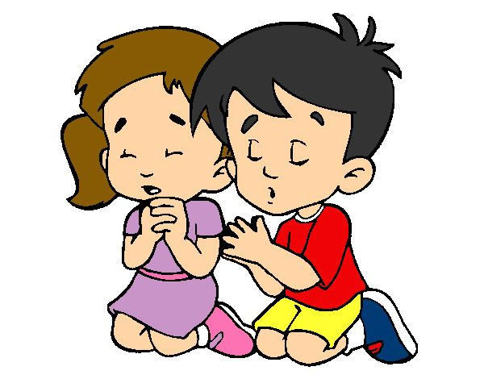
PRAY

Slide 3
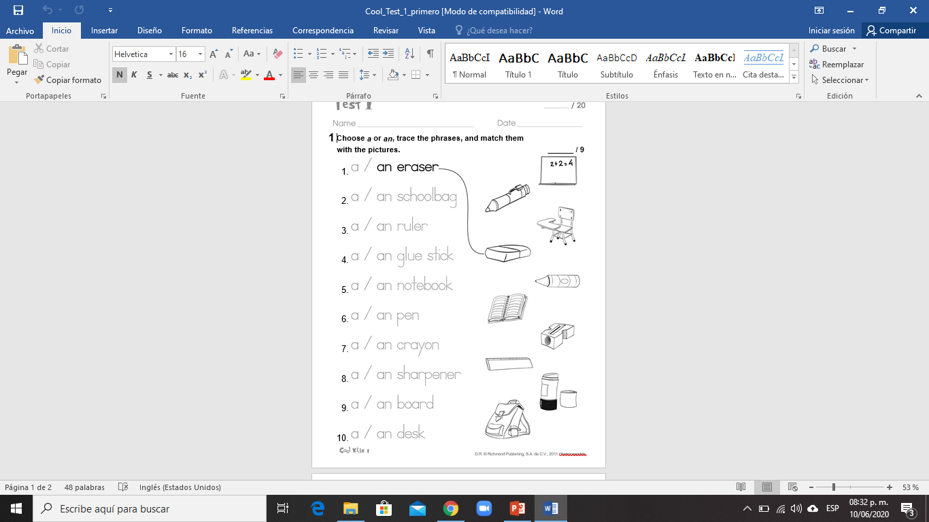
TEST

Slide 4
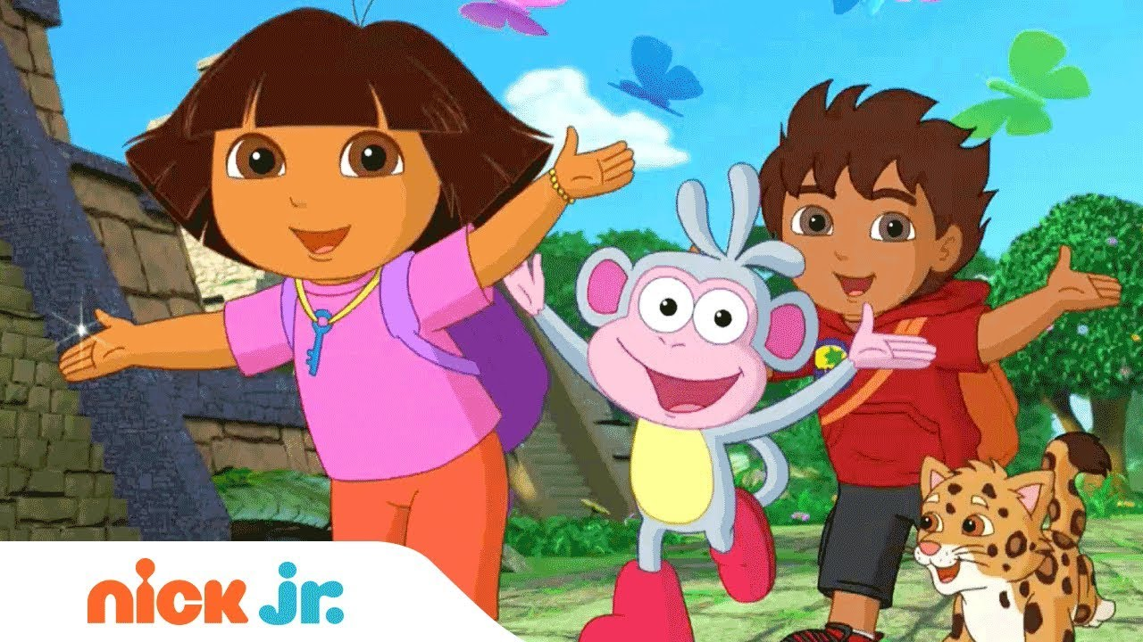
THANK YOU
SEE YOU TOMORROW. STAY AT HOME

